Slide 1
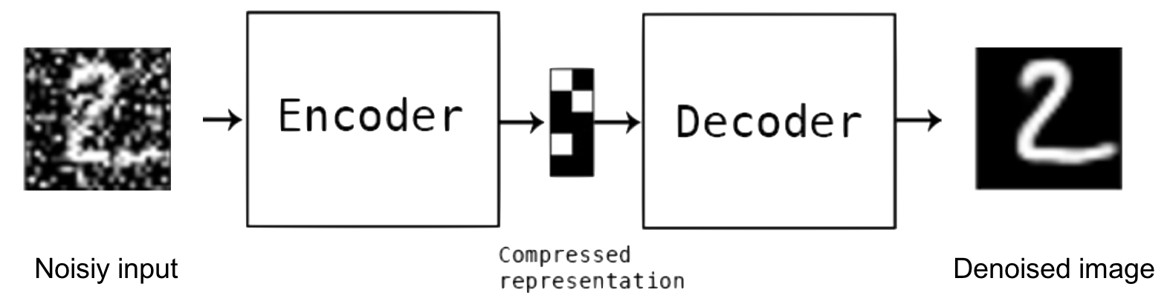
Training data
Which images are likely in 𝒮?

Slide 2
Which images are likely in 𝒮?

Slide 4
d
k
d
d
x^{T}
=
f(x)^{T}
W₂
W₁

Slide 5
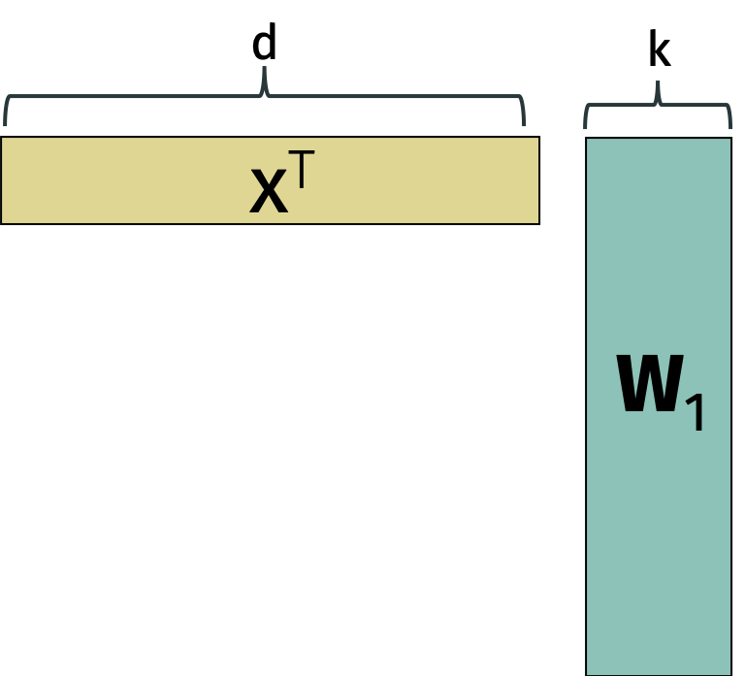
encoder
d
z
=
f(x)^{T}
W₂
k
decoder

Slide 6
d
k
d
d
x₁
f(x₁)
W₂
x₂
f(x₂)
W₁
=
~
X
X
x_{n}
f(x_{n})

Slide 7
k
d
d
z₁
W₂
z₂
=
~
Z= XV_{k}
X
z_{n}

Slide 8
k
d
d
z₁
V_{k}^{T}
z₂
loading
vectors
=
~
Z= XV_{k}
X
z_{n}
principal components

Slide 9
d
k
d
x₁
c₁
V^{T}
x₂
c₂
X
=
C
+
R
x_{n}
c_{n}

Slide 10
=
1
0
U^{T}
U
1
1
0
1
1

